Slide 1


Spam Email Detection
✉ Gloria Grace
✉ Emma Wang
✉ Abigail Musser
SpPamm? Nahhh h

Slide 2
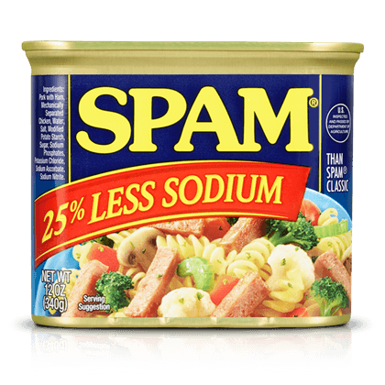
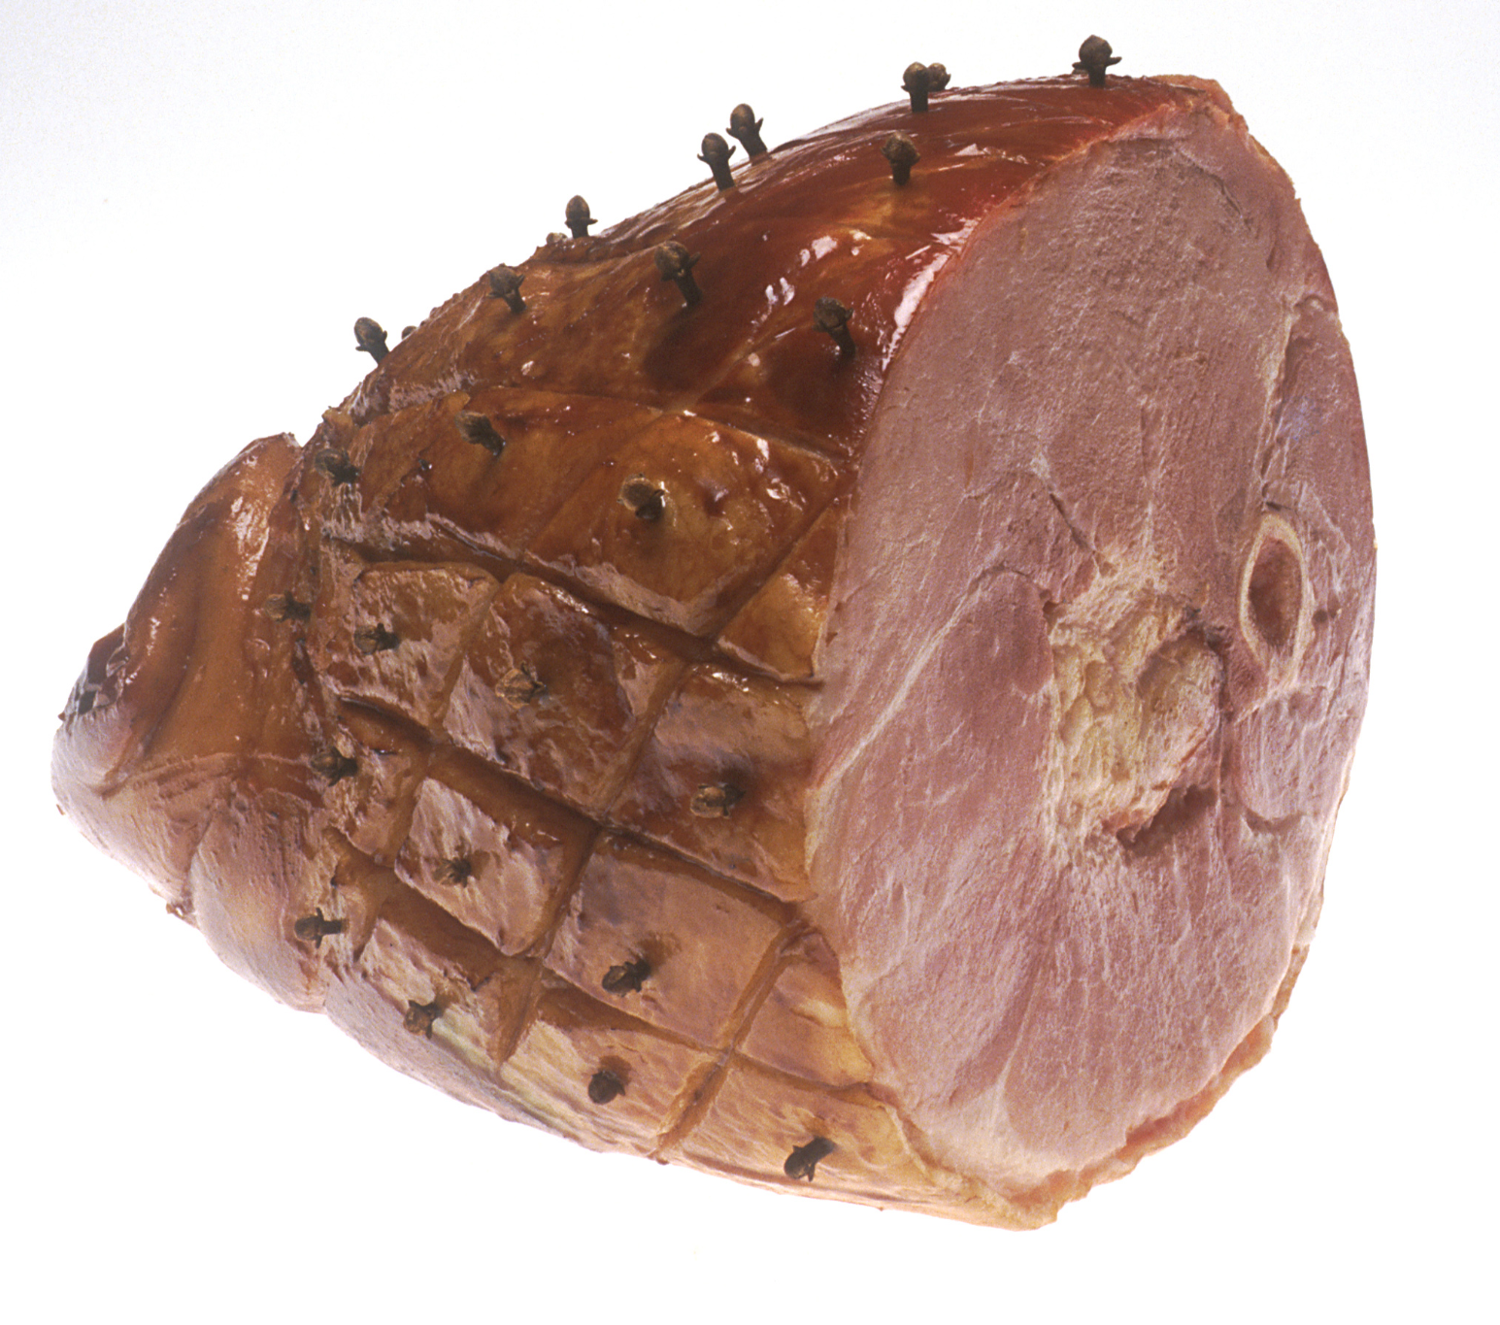
Project Goals
To detect and classify emails as spam or ham
To optimize the performance of the spam email detection model by experimenting with different text preprocessing techniques
Notes:
Abigail
To detect and classify emails as spam or ham
What problem are you trying to solve?

Slide 3
Approach
Classification
Hyperparameter tuning
Validation approach
Tokenization
Dataset: Enron email dataset
Output: a probability that gets classified as 0 or 1 (ham or spam)
Notes:
Gloria

Slide 4

“DEMO”
Notes:
Emma

Slide 5
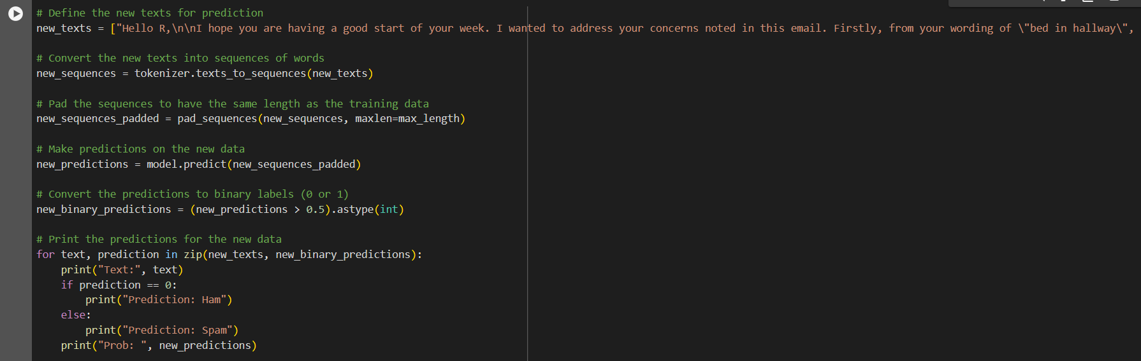

Slide 6
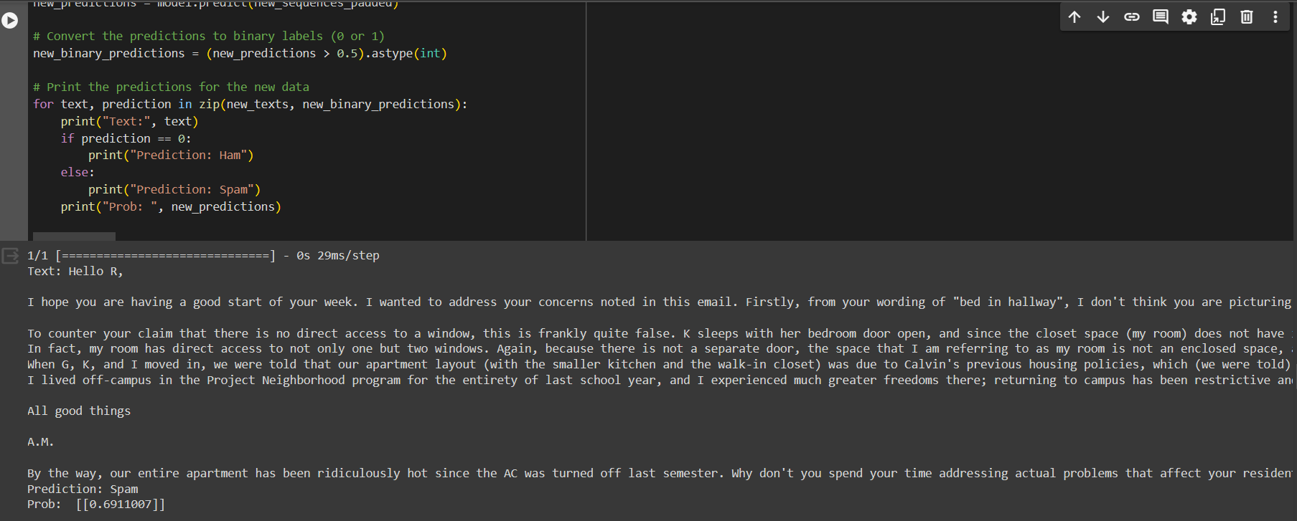

Slide 7
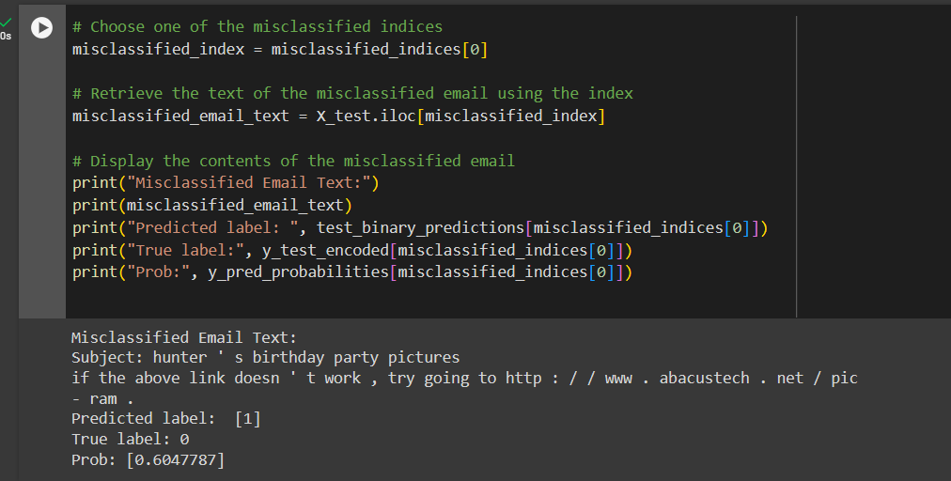

Slide 8
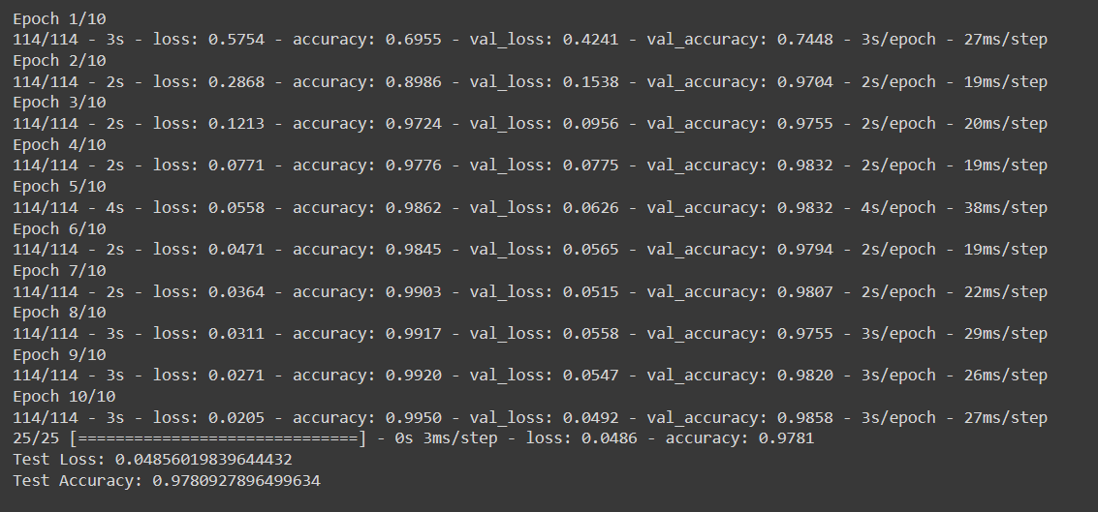
Results
The model was trained for 10 epochs, with a final accuracy of 98% on the test data.
Notes:
Abigail

Slide 9
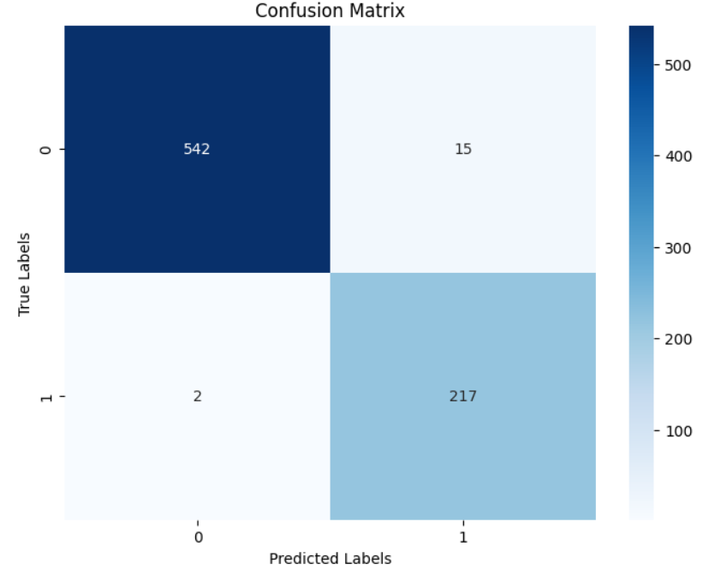
Results
Notes:
Abigail
A false positive is a legit email that is misidentified as spam.
More false positives than false negatives in training set

Slide 10
What We Learned
The distribution between the ham and spam emails.
Machine learning is associated with various tasks such as classification, regression, clustering, and pattern recognition, among others.
Techniques such as dropout regularization and optimization algorithms like Adam have been tried to enhance model performance.
Notes:
Gloria
What did you learn? you could take this in various ways:
about your problem?
about the model or data you’re using?
about AI/ML more generally?
about your problem-solving process?
etc.

Slide 11
Other Takeaways
Limitations
Relies on the patterns of the training dataset 🚂
Not is regularly updated
Imbalance dataset leads to possible bias
Broader questions this project might raise:
Privacy concerns of whether spam email detection systems analyze the content of emails is stored or shared with third parties
Future Directions:
Collect more spam emails
Adjusting model hyperparameters
Explore other alternatives
Notes:
Emma

